Slide 1

Reading and Responding AT3
What have you read in the last 12 hours?
Newspaper?
Cereal packet?
Advert?
Timetable?
Novel
Academic article?
E-mail?

Slide 2
Did you read every word?
Newspaper?
Cereal packet?
Advert?
Timetable?
Novel
Academic article?
E-mail?
Translation
How much did you need to understand?
Can you put a % next to each of these reading activities?
It depends on your purpose for reading…
100% +

Slide 3

What if I have to read an academic article in 15 mins?

Slide 4
Before..
Your life depends on it!!

Slide 5
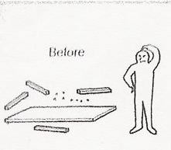
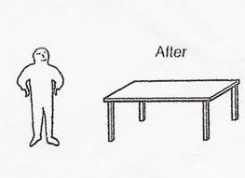
Text as a do-it-yourself kit
The effort the reader needs to contribute
Experience/prediction
Making sense of the text

Slide 6
Objectives
By the end of this session we will have explored:
Why and How and we read
Why we should include reading in our teaching
How to choose texts
How to exploit them
Strategies to help our learners read

Slide 7
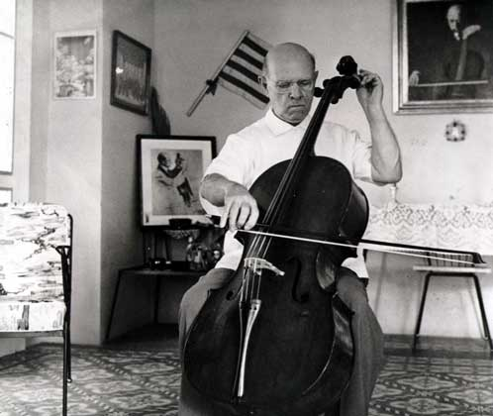

Slide 8
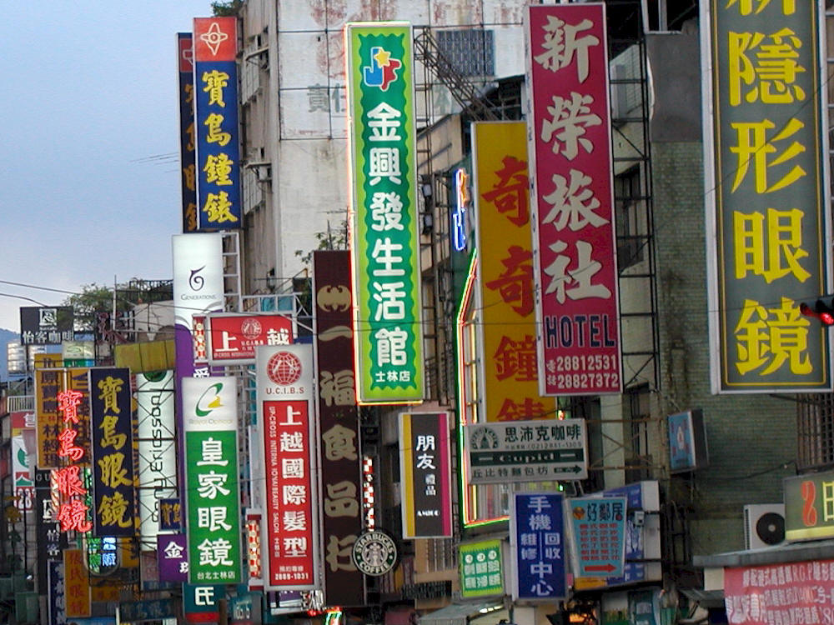
Strategies
Can you read this?
Prediction
Knowledge of the world
Knowledge of the language?
Notes:
A lot of skills which could be said to be more life skills or common sense.

Slide 9

Strategies…..and this?
Notes:
Advertising logos clues

Slide 10
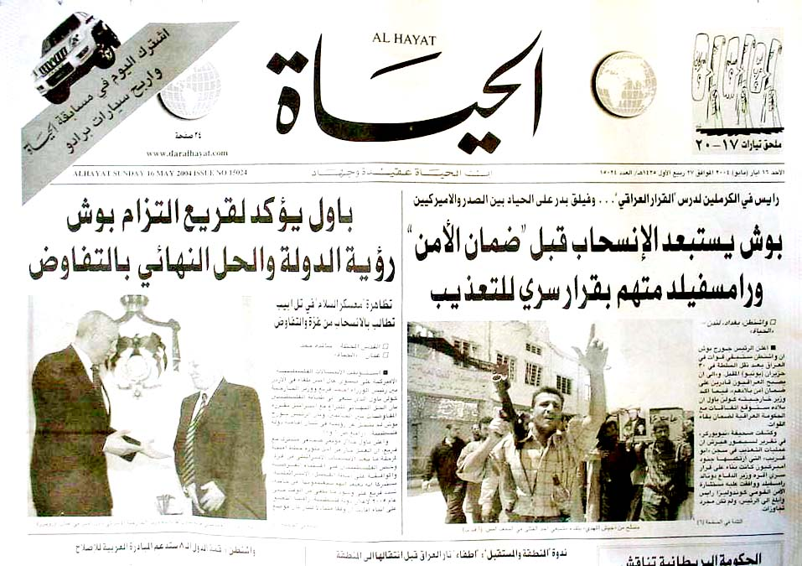
And this one? What are the headlines

Slide 11
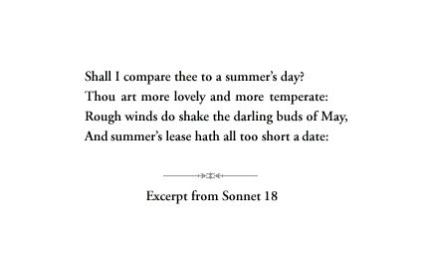
Notes:
Shape of the text

Slide 12
Strategies
Prediction
Knowledge of the world
Visual clues
Knowledge of texts (shape)
Notes:
Dialogue=number of speakers

Slide 13
Messages for our students?
You don’t need to understand every word to understand a text
You know more than you think before you read the words
reading≠ translation!

Slide 14
Problems?
What was your experience of reading?
How much reading have you seen in the classroom?
What do the students think?
What’s available for reading?
  Texts
  Course books
  Reading books?

Slide 15
Why bother?
Authentic
Offers possibilities for autonomy
Variety
Pleasure
Differentiation
Cultural background
Grammar in action

Slide 16

When should we start?
But I thought…
Wit=huit
Say=c’est
Key=qui
Cup=Kap
Thought=Soht
Use=Jus

Slide 17
Which text?
Time?
Preparation?
Exploitation?
Investment v pay off?

Slide 18
Which text?
Experience of
  Target language
  Experience of life
  Experience of reading
  Linguistic challenges (grammar/ vocabulary)
Notes:
consider

Slide 19
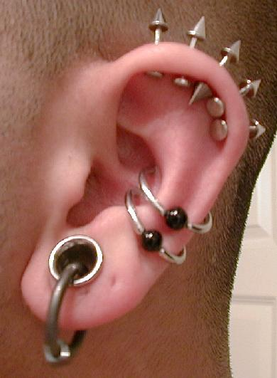
How to exploit reading activities?
Links?
  Listening
  Before, during and after…
Differences?
  Easier
  Stimulus available
Notes:
Elicit Gary’s listening lecture

Slide 20
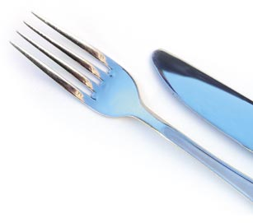
Reading is like a meal
Waiter brings the menu (anticipation)
Einstieg/Amuse-gueule ¿Tapa?
The starter
The main course
The dessert
Notes:
Put another course in there aperitif/coffee /tapa

Slide 21
How..?
Known to unknown
Simple to complex
Global to detailed
4 phase approach
Notes:
elicit

Slide 22
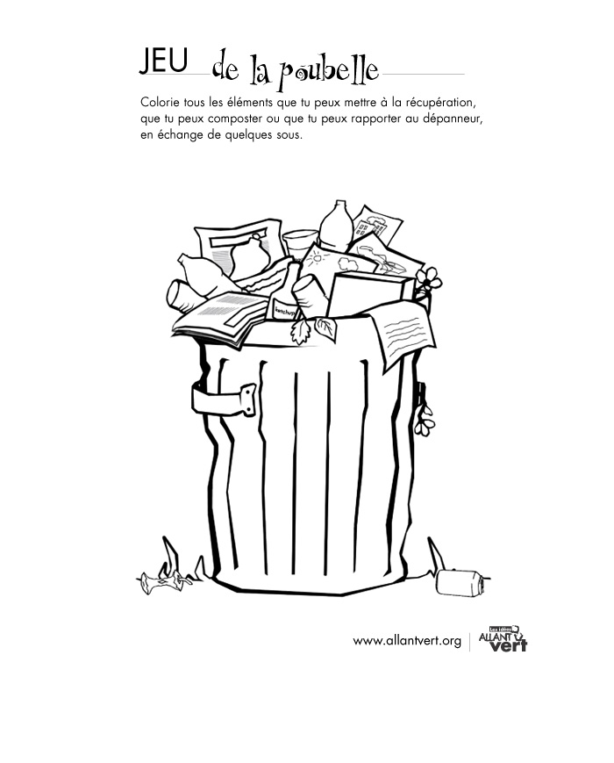
Before.
Suggestions..?
Visuals
Realia-bag of objects
Music

Slide 23
TEXT attack:Pre-reading
Knowledge of the world & language:
  Brainstorming
  Lists
  Word searches

Slide 24
Before..
Your life depends on it!!

Slide 25
TEXT attack: “During”
Why global to…?
Get the context/big picture
Building on what they know
Drawing on prediction and inference to provide scaffolding
Reading strategies
Reduces anxiety

Slide 26

TEXT attack:examples
Scan
  Titles
  Subtitles
  Images
Notes:
Treat every text like a newspaper

Slide 27

TEXT attack:during……gist
Match captions to pictures
Titles to paragraphs
Sort
Jigsaw

Slide 28
Word attack:the tock
She picked up the tock
And then she drank
Just at that moment the tock slipped from her grasp and …
Broke into a thousand pieces!
Notes:
Some of you will know this one!

Slide 29
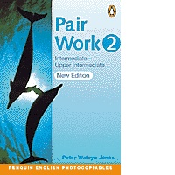
Suggestions…
Context
Cognates
Think aloud strategies (TL or English?)
Peer/collaborative work
TL?
Dictionary? When? How often?

Slide 30
During: detail
Complete a chart/diagram
True /false
Systematic language work
  Verb/adjectival endings -cloze

Slide 31
And after…
Creative writing
Reactions/reviews
An alternative ending
Different perspective/character’s point of view
Cartoon strip
Poster
Film/play script
Role play
Prepare own activities for the text
Notes:
Post reading activities

Slide 32
Reading aloud?
What are your experiences of this
  as a reader/as a listener?
And the students at your practice school?

Slide 33
If we ask them to read aloud..
They must
Understand what they are reading
Have seen the text before
Have time to prepare
Annotate the text to indicate pronunciation issues
Record themselves/pair work?
Notes:
Liaisons
Aide memoire for difficult sounds

Slide 34
Doing it differently..?
Try a role play (scripted or unscripted) with adverbs as prompts…
Angrily
Romantically
Hesitantly
Hyperactively
Impatiently
In a horror film
Notes:
Get them to buy some bread by row with an adverb of manner

Slide 35
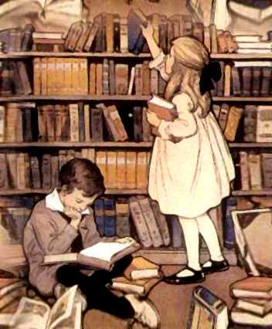
Reading for pleasure
Choice
Extensive reading
Autonomy
Differentiation

Slide 36
Last thoughts..
How much reading is done in the classroom where the emphasis is on communication?
Settling and stirring?
Try to incorporate strategy work into a reading activity soon!

Slide 37
Storyline
http://www.creativedialogues.lernnetz.de/docs/journeybinder.pdf

Slide 38
Reading is like a meal
Waiter brings the menu (anticipation)
The starter
The main course
The dessert

Slide 39
What if I have to read an academic article in 15 mins?

Slide 40
Time to read is …
“…..always time stolen. By making time to read like time to love, we expand our time for living”
(Pennac, D. 2006 The Rights of the Reader Walker Books)
And who could be too busy for that?

